Slide 1
Udacity

Slide 2
Description
a neural network is used to clone car driving behavior
it is a supervised regression problem between the car steering angles and the road images in front of a car
the images were taken from three different camera angles (from the center, the left and the right of the car)
the network is based on The NVIDIA model, which has been proven to work in this problem domain
as image processing is involved, the model is using convolutional layers

Slide 3
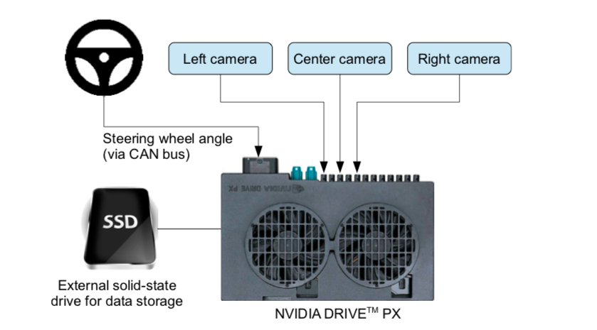
Source: https://arxiv.org/pdf/1604.07316v1.pdf
Notes:
The NVIDIA model: https://arxiv.org/pdf/1604.07316v1.pdf

Slide 4
Model Architecture Design
deep convolution network which works well with supervised image classification / regression problems
the convolution layers are meant to handle feature engineering and the fully connected layer for predicting the steering angle
the model:
Image normalization
Convolution: 5x5, filter: 24, strides: 2x2, activation: ELU
Convolution: 5x5, filter: 36, strides: 2x2, activation: ELU
Convolution: 5x5, filter: 48, strides: 2x2, activation: ELU
Convolution: 3x3, filter: 64, strides: 1x1, activation: ELU
Convolution: 3x3, filter: 64, strides: 1x1, activation: ELU
Drop out (0.5)
Fully connected: neurons: 100, activation: ELU
Fully connected: neurons: 50, activation: ELU
Fully connected: neurons: 10, activation: ELU
Fully connected: neurons: 1 (output)

Slide 5
Training
Training data contains single images sampled from the video, paired with the corresponding steering command (1/r) gathered in a CSV log
The training data is therefore augmented with additional images that show the car in different shifts from the center of the lane and rotations from the direction of the road
Goal: find correlation between x = the input from the right, center, left camera and y = the steering command
mean squared error used for the loss function to measure how close the model predicts to the given steering angle for each image.
Notes:
Training data contains single images sampled from the video, paired with the corresponding steering command (1/r). Training with data from only the human driver is not sufficient. The network must learn how to recover from mistakes. Otherwise the car will slowly drift off the road. The training data is therefore augmented with additional images that show the car in different shifts from the center of the lane and rotations from the direction of the road.
We use 1/r instead of r to prevent a singularity when driving straight (the turning radius for driving straight is infinity). 1/r smoothly transitions through zero from left turns (negative values) to right turns (positive values).

Slide 6
Training Model
For training, I used the following augmentation technique along with Python generator to generate unlimited number of images:
Randomly choose right, left or center images.
For left image, steering angle is adjusted by +0.2
For right image, steering angle is adjusted by -0.2
Randomly flip image left/right
Randomly translate image horizontally with steering angle adjustment (0.002 per pixel shift)
Randomly translate image virtically
Randomly added shadows
Randomly altering image brightness (lighter or darker)

Slide 7
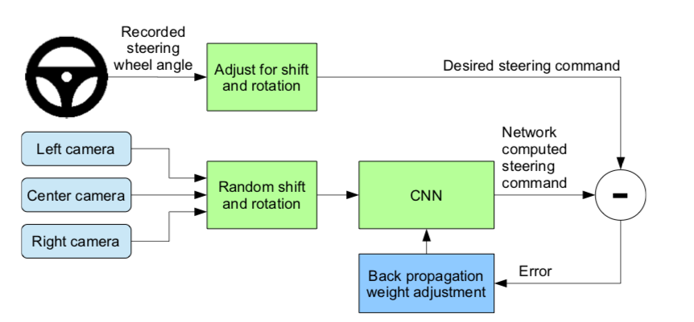
Source: https://arxiv.org/pdf/1604.07316v1.pdf

Slide 8
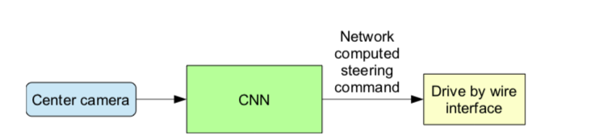
Training Outcome
Source: https://arxiv.org/pdf/1604.07316v1.pdf

Slide 9
Autonomous Mode
Data is collected from the three cameras in a CSV log
This data is used to train the model
The model runs for 10 epochs

Slide 10
Apollo
http://apollo.auto

Slide 11
References
https://github.com/lachezarbozhkov/Self-Driving-Car-Simulator
https://github.com/llSourcell/How_to_simulate_a_self_driving_car.git
https://devblogs.nvidia.com/deep-learning-self-driving-cars/
https://github.com/naokishibuya/car-behavioral-cloning

